Slide 1
Predict wine
quality rating
results and conclusions
github
Elena Kochetova linkedin.com/in/elena-kochetova

Slide 2
Description
Predict wine quality rating
Sarmo Labs Internship
Sep - Oct 2023
Objective:
Predict wine quality rating and identify the key factors that influence it.
Dataset Details:
The datasets are related to the red and white variants of the Portuguese Vinho Verde wine. The goal is to model wine quality based on physicochemical tests.
Business Insights and Recommendations:
Rank features by their influence on wine quality.
Provide insights on which physicochemical properties should be prioritized to produce high-quality wine.
Offer any other relevant recommendations or insights derived from the analysis.

Slide 3
Results & Business Insights

Slide 4
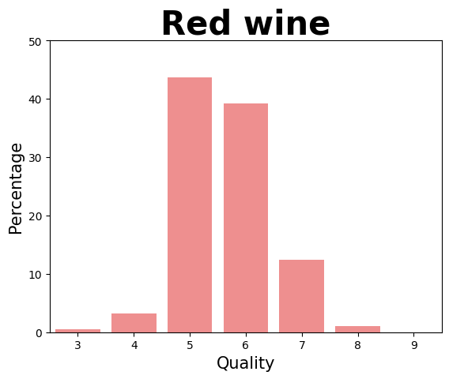
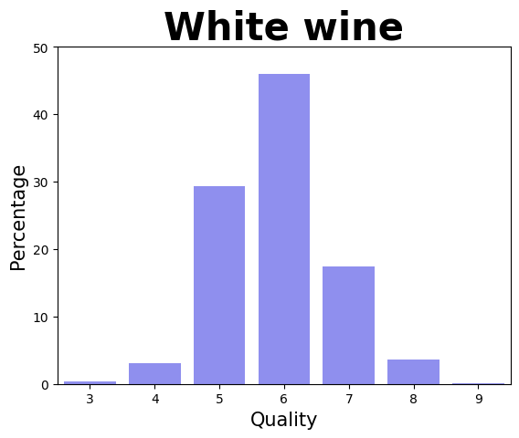
Wine type - Quality
- Quality

Slide 5
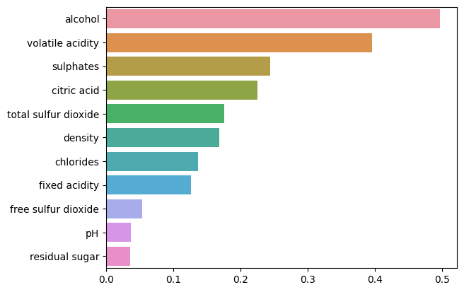
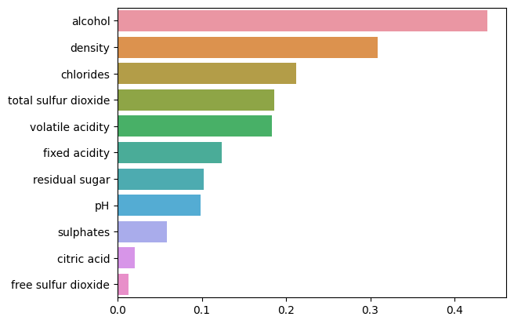
Wine type
Red wine
White wine

Slide 6
Recommendations:
Consideration of Key Parameters:
Red wine | White wine
Alcohol | Alcohol
Volatile Acidity | Density
Sulphates | Chlorides

Slide 7
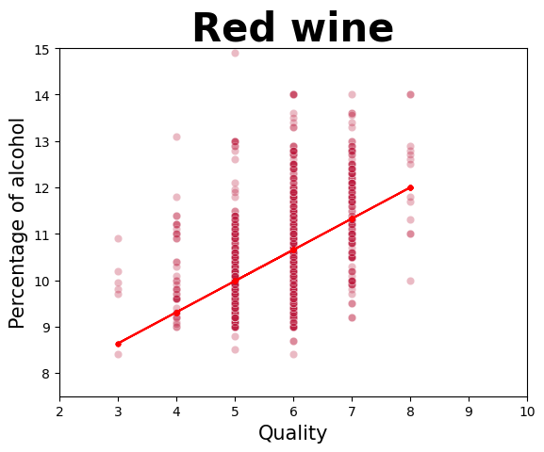
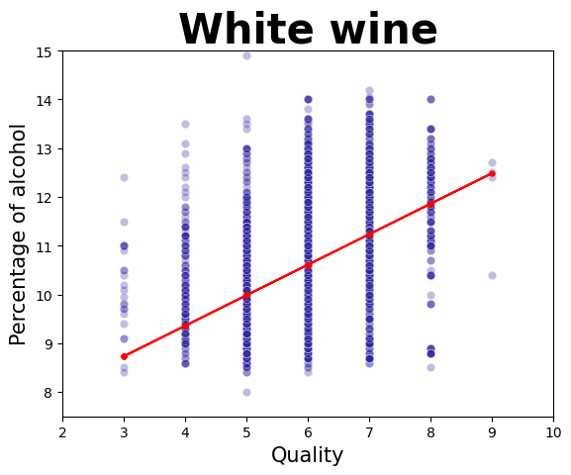
Alcohol content for Red & White wine

Slide 8
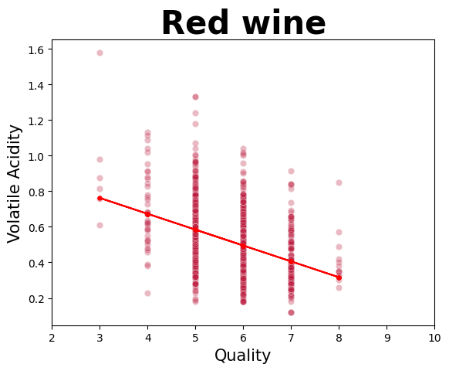
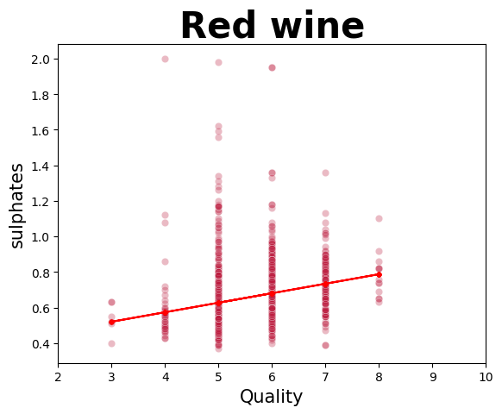
Volatile Acidity & Sulphates for Red wine

Slide 9
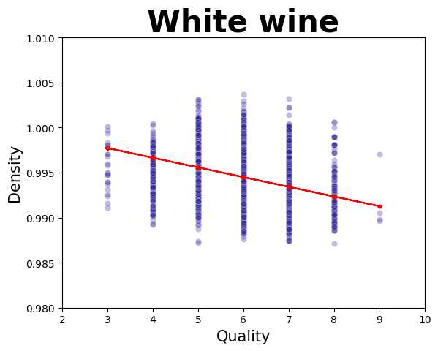
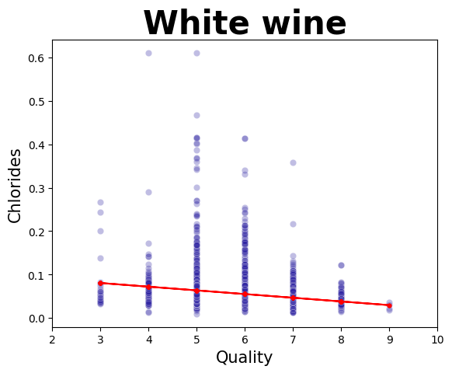
Density & Chlorides for White wine

Slide 10
Recommendations:
Consideration of Key Parameters:
To enhance the quality of wine, it is essential to focus on controlling key parameters that have a significant impact on the wine's quality assessment
Red wine | White wine
Alcohol | Alcohol
Volatile Acidity | Density
Sulphates | Chlorides

Slide 11
Recommendations:
Discarding Insignificant Parameters:
This will help reduce production costs and resources without compromising quality.
Red wine | White wine
Citric Acid Total Sulfur Dioxide Density Chlorides Fixed Acidity Free Sulfur Dioxide pH Residual Sugar | Total Sulfur Dioxide Volatile Acidity Fixed Acidity Residual Sugar pH Sulphates Citric Acid Free Sulfur Dioxide

Slide 12
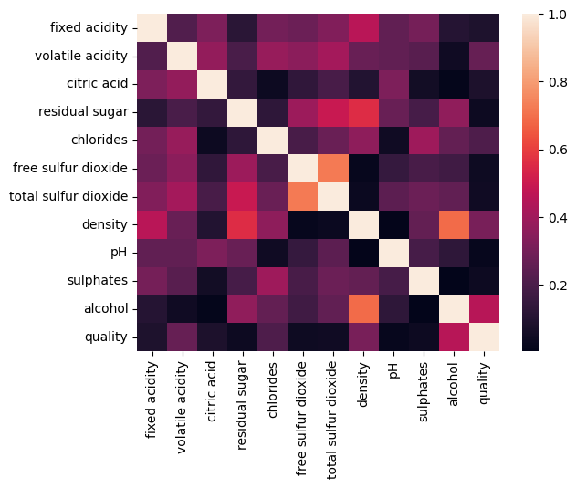
Parameters Correlation Heatmap:
A correlation heatmap of parameters provides valuable insights for optimizing wine production and enhancing its quality.

Slide 13
Alcohol content - Quality

Slide 14
Recommendations:
Creating a Segment of High-Quality Wine:
Define a threshold value for wine quality that will be considered high.
Allocate production and marketing efforts for wines with a quality rating above the established threshold.
This will allow you to create an attractive segment for wine connoisseurs and promote them more effectively in the market.
Maintain strict quality control for wines included in this segment to ensure consistent quality.
Additional Data Analysis:
Utilize machine learning models to predict which wines will belong to the high-quality segment based on their current characteristics.

Slide 15
Prediction Model:
Developed a ML model for predicting wine quality based on physicochemical parameters.
Achieved the following RMSE scores on the test data:
DecisionTreeRegressor: RMSE = 0.81
Linear Regression: RMSE = 0.57
RandomForestRegressor: RMSE = 0.39
The RandomForestRegressor model demonstrated the best performance, making it the most suitable for predicting wine quality.

Slide 16

Thank you for your attention!
Elena Kochetova
https://www.linkedin.com/in/elena-kochetova/

